Slide 1



Noida Institute of Engineering and Technology, Greater Noida
HTML & XML
Unit: 2
Subject Name:
WEB TECHNOLOGY (Subject
Code is not Assigned) )
Ajeet Kumar
Assistant Professor
CSE Department
Course Details
(B Tech. 5th Sem)
Ajeet Kumar WT Unit 1

Slide 2


Syllabus Unit - 1
Introduction:Introduction to Web Technology, History of Web and Internet, Connecting to Internet, Introduction to Internet services and tools, Client-Server Computing, Protocols Governing Web, Basic principles involved in developing a web site, Planning process,Types of Websites,WebStandardsandW3C recommendations,
Web Hosting: Web Hosting Basics, Types of Hosting Packages, Registering domains, DefiningName Servers, Using Control Panel, Creating Emails in Cpanel, Using FTP Client, Maintaining aWebsite.
Ajeet Kumar WT UNIT 2

Slide 3
Syllabus Unit - 2
HTML:WhatisHTML, DOM- Introduction to Document Object Model,BasicstructureofanHTMLdocument,MarkupTags, Heading-Paragraphs,LineBreaks, Understand the structure of HTML tables. Lists, Working with Hyperlinks, Image Handling, Understanding Frames and their needs, HTML forms for User inputs. New form Elements- date, number, range, email, search anddatalist, Understanding audio, video and article tags.
XML: Introduction, Tree, Syntax, Elements, Attributes, Namespaces, Display, HTTP request, Parser, DOM, XPath, XSLT, XQuerry, XLink, Validator, DTD, Schema, Server
Ajeet Kumar WT UNIT 2

Slide 4
Syllabus Unit - 3
Concept of CSS 3: Creating Style Sheet, CSS Properties , CSS Styling(Background, Text Format,Controlling Fonts) , Working with block elements and objects , Working with Lists and Tables ,CSSIdandClass,BoxModel(Introduction,Borderproperties,PaddingProperties,Marginproperties) CSS Advanced(Grouping, Dimension, Display, Positioning, Floating, Align, Pseudoclass,NavigationBar,ImageSprites,Attributesector),CSSColor,CreatingpageLayoutandSite.
Bootstrap: Introduction, Bootstrap grid system, Bootstrap Components.
Ajeet Kumar WT UNIT 2

Slide 5
Syllabus Unit - 4
JavaScript Essentials: Introduction to Java Script ,Javascript Types , Var, Let and Const Keywords, Operators in JS , Conditions Statements , Java Script Loops, JS Popup Boxes , JS Events , JSArrays,WorkingwithArrays,JSObjects,JSFunctions,UsingJavaScriptinRealtime,ValidationofForms,Arrow functions and default arguments, Template Strings, Strings methods, Callback functions, Object de-structuring, Spread and Rest Operator, Typescript fundamentals, Typescript OOPs- Classes, Interfaces, Constructor etc. Decorator and Spread Operator,
Difference == & ===, Asynchronous Programming in ES6, Promise Constructor, Promise with Chain, Promise Race.
Ajeet Kumar WT UNIT 2

Slide 6
Syllabus Unit - 5
Introduction to PHP, Basic Syntax, Variables & Constants, Data Type, Operator & Expressions, Control flow and Decision making statements, Functions, Strings, Arrays,
Working with files and directories: Understanding file& directory, Opening and closing, a file, Coping, renaming and deleting a file, working with directories, Creating and deleting folder, File Uploading & Downloading.
Session & Cookies: Introduction to Session Control, Session Functionality What is a Cookie, Setting Cookies with PHP. Using Cookies with Sessions, Deleting Cookies, Registering Session variables, Destroying the variables and Session.
Ajeet Kumar WT UNIT 2

Slide 7
Text Books
StevenM.Schafer,“HTML,XHTML,andCSSBible,5ed”,WileyIndia
IanPouncey,RichardYork,“BeginningCSS:CascadingStyleSheetsforWebDesign”,WileyIndia
Ajeet Kumar WT UNIT 2

Slide 8
End Semester Question Paper Template
B TECH
(SEM-V) THEORY EXAMINATION 20__-20__
Time: 3 Hours Total Marks: 100
Note: 1. Attempt all Sections. If require any missing data; then choose suitably.
SECTION A
Attempt all questions in brief. 1 x 10 = 10
Q.No. | Question | Marks | CO
1 |  | 1
2 |  | 1
. |  | .
10 |  | 1
Ajeet Kumar WT UNIT 2

Slide 9
End Semester Question Paper Templates
2. Attempt of the following: 5 x 2 = 20
SECTION B
3. Attempt any five part of the following: 5 x 6 = 30
Q.No. | Question | Marks | CO
1 |  | 2
2 |  | 2
“”” |  | ‘”
5 |  | 2
Q.No. | Question | Marks | CO
1 |  | 6
. |  | 6
7 |  | 6
Ajeet Kumar WT UNIT 2

Slide 10
End Semester Question Paper Templates
4. Attempt any one part of the following: 1 x 10 = 10
5. Attempt any one part of the following: 1 x 10 = 10
6. Attempt any one part of the following: 1 x 10 = 10
Q.No. | Question | Marks | CO
1 |  | 10
2 |  | 10
Q.No. | Question | Marks | CO
1 |  | 10
2 |  | 10
Q.No. | Question | Marks | CO
1 |  | 10
2 |  | 10
Ajeet Kumar WT UNIT 2

Slide 11
End Semester Question Paper Templates
4. Attempt any one part of the following: 1 x 10 = 10
5. Attempt any one part of the following: 1 x 10 = 10
6. Attempt any one part of the following: 1 x 10 = 10
Q.No. | Question | Marks | CO
1 |  | 10
2 |  | 10
Q.No. | Question | Marks | CO
1 |  | 10
2 |  | 10
Q.No. | Question | Marks | CO
1 |  | 10
2 |  | 10
Ajeet Kumar WT UNIT 2

Slide 12
Prerequisites & Recap
Prerequisites:
Basic Knowledge of any programming language like C/C++/Python/Java. Familiarity with basic concepts of Internet.
Ajeet Kumar WT UNIT 2

Slide 13
Prerequisites & Recap
Recap:
Previous unit was focused on web development strategies with some internet services and tools and connecting cables for internet .
The main concepts discussed of core java are: Object, classes, inheritance, polymorphism ,package and interfaces in Java language.
The some concepts about exception handling , multithreading, IO packages, AWT, Applet and Layout manager classes in details.
Ajeet Kumar WT UNIT 2

Slide 14
Brief Introduction About The Subject
Web technologies are the various tools and techniques that are utilized in the process of communication between different types of devices over the internet.
To understand this term in a better manner, let’s break it down into two pieces: ‘web’ and ‘technology’.
The web, in this case, refers to the World Wide Web, more commonly known as WWW.
It first came into being in 1989 when famous scientist and engineer, Tim Berners-Lee, came up with an efficient mechanism to share resources between scientists all over the world.
https://www.youtube.com/results?search_query=Web+Technonogies
Ajeet Kumar WT UNIT 2

Slide 15
Content of Unit 2
Introduction to HTML
Introduction to DOM
Structure of HTML Document
Markup Tags
Heading-Paragraphs, Line Breaks
HTML Table
HTML List
Working of Hyperlinks
HTML images and frames
HTML form and control
Audio, Video and Article Tags
Ajeet Kumar WT UNIT 2

Slide 16
Content of Unit 2 (Cont..)
Introduction to Extended Mark up language (XML)
XML DTD, Schema and Object model
Tree, Syntax, Elements, Attributes, Display
HTTP Request, Parser, DOM
XPath, XSLT, XQuery, XLink, Validator
DTD, Schema, Server
Ajeet Kumar WT UNIT 2

Slide 17
Unit Objective
Objective of Unit 2:
To understand the concepts of web designing
To understand the concepts of history of web
To understand the concepts of tags of HTML
Topic’s Objective:
To understand the concepts of HTML, List, Tables attributes and Borders.
Ajeet Kumar WT UNIT 2

Slide 18
HTML
HTML stands for Hyper Text Markup Language
HTML is the standard markup language for creating Web pages
HTML describes the structure of a Web page
HTML consists of a series of elements
HTML elements tell the browser how to display the content
HTML elements label pieces of content such as "this is a heading", "this is a paragraph", "this is a link", etc.
HTML is an acronym which stands for Hyper Text Markup Language which is used for creating web pages and web applications. Let's see what is meant by Hypertext Markup Language, and Web page.
Ajeet Kumar WT UNIT 2

Slide 19
HTML (Cont..)
Markup language: A markup language is a computer language that is used to apply layout and formatting conventions to a text document. Markup language makes text more interactive and dynamic. It can turn text into images, tables, links, etc.
Web Page: A web page is a document which is commonly written in HTML and translated by a web browser. A web page can be identified by entering an URL. A Web page can be of the static or dynamic type. With the help of HTML only, we can create static web pages.
Ajeet Kumar WT UNIT 2

Slide 20
HTML (Cont..)
An HTML document is made of many HTML tags and each HTML tag contains different content.
<!DOCTYPE html>
<html>
<head>
<title>Page Title</title>
</head>
<body>
<h1>My First Heading</h1>
<p>My first paragraph.</p>
</body>
</html>
Ajeet Kumar WT UNIT 2

Slide 21
HTML (Cont..)
Example Explained
The <!DOCTYPE html> declaration defines that this document is an HTML5 document
The <html> element is the root element of an HTML page
The <head> element contains meta information about the HTML page
The <title> element specifies a title for the HTML page (which is shown in the browser's title bar or in the page's tab)
The <body> element defines the document's body, and is a container for all the visible contents, such as headings, paragraphs, images, hyperlinks, tables, lists, etc.
The <h1> element defines a large heading
The <p> element defines a paragraph
Ajeet Kumar WT UNIT 2

Slide 22
HTML (Cont..)
HTML Element
An HTML element is defined by a start tag, some content, and an end tag:
<tagname> Content goes here... </tagname>
Document Object Model:
The Document Object Model is a cross-platform and language-independent interface that treats an XML or HTML document as a tree structure wherein each node is an object representing a part of the document. The DOM represents a document with a logical tree.
Ajeet Kumar WT UNIT 2

Slide 23
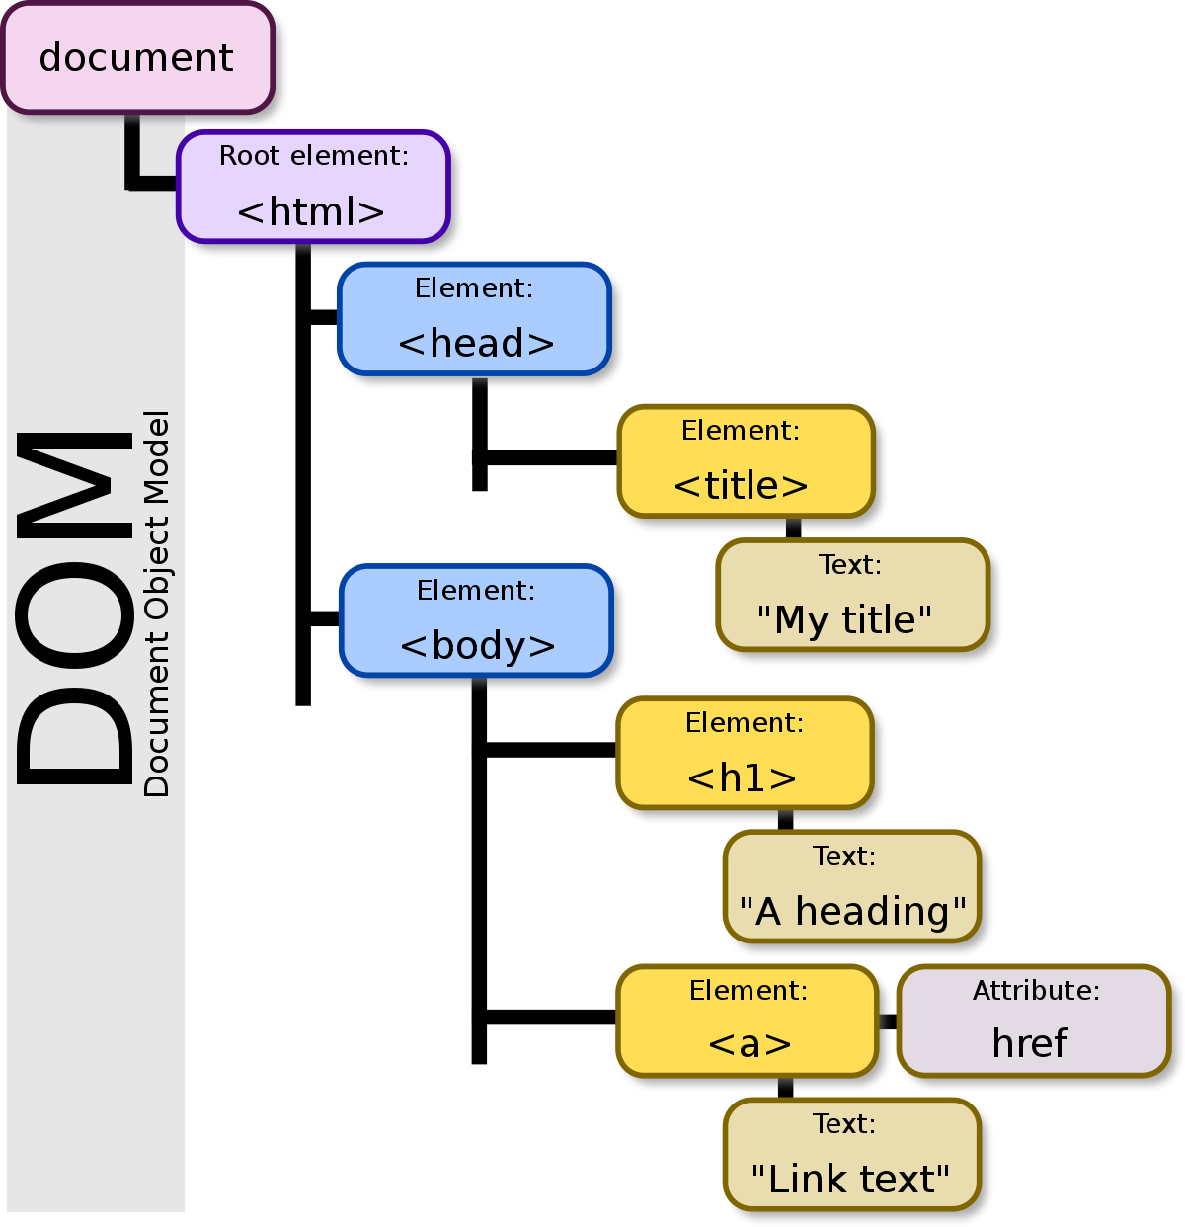
Document Object Model
Ajeet Kumar WT UNIT 2

Slide 24
Structure of HTML
<html>
<head>
<title>Page title</title>
</head>
<body>
<h1>This is a heading</h1>
<p>This is a paragraph.</p>
<p>This is another paragraph.</p>
</body>
</html>
The content inside the <body> section (the white area above) will be displayed in a browser. The content inside the <title> element will be shown in the browser's title bar or in the page's tab.
Ajeet Kumar WT UNIT 2

Slide 25
Markup Tags
A “markup tag” is the fundamental characteristic of HTML. Every markup tag is a command placed between “wickets” or “angle brackets”—a left bracket (<) and a right bracket (>). Markup tags are not revealed by a web browser; they are invisible.
In most cases, markup tags (containing commands) come in pairs, with text or a graphic image located between the beginning and ending tags:
<COMMAND>text or graphic image</COMMAND>: controls or regulates the text or graphic image information between the two non-empty markup tags.
Ajeet Kumar WT UNIT 2

Slide 26
Markup Tags (Cont..)
Pairs of markup tags are referred to as “non-empty” tags, because something is contained between the beginning tag and the ending tag. A beginning tag and an ending tag are identical, except a “slash” (/) is placed before the command of the ending tag to tell the browser that the command has been completed.
Paragraph:
A paragraph always starts on a new line, and browsers automatically add some white space (a margin) before and after a paragraph. HTML paragraph or HTML p tag is used to define a paragraph in a webpage.
An HTML <p> tag indicates starting of new paragraph.
Ajeet Kumar WT UNIT 2

Slide 27
HTML Paragraph and Break line
Example of HTML Paragraph Tag:
<p>This is a paragraph.</p>
<p>This is another paragraph.</p>
Example of HTML Paragraph Tag: (<br>)
Used to insert single line breaks in a text.
The <br> tag inserts a single line break.
The <br> tag is useful for writing addresses or poems.
The <br> tag is an empty tag which means that it has no end tag.
Use the <br> tag to enter line breaks, not to add space between paragraphs.
Ajeet Kumar WT UNIT 2

Slide 28
HTML Paragraph and Break line
Example of Line Breaks:
<p>To force<br> line breaks<br> in a text,<br> use the br<br> element.</p>
Output:
To force
line breaks
in a text,
use the br
element.
Ajeet Kumar WT UNIT 2

Slide 29
HTML List
HTML Lists are used to specify lists of information. All lists may contain one or more list elements. There are three different types of HTML lists:
Ordered List or Numbered List (ol)
Unordered List or Bulleted List (ul)
Description List or Definition List (dl)
HTML Ordered List:
In the ordered HTML lists, all the list items are marked with numbers by default. It is known as numbered list also. The ordered list starts with <ol> tag and the list items start with <li> tag.
Ajeet Kumar WT UNIT 2

Slide 30
HTML List (Cont..)
HTML Ordered List Example:
<ol>
<li>Aries</li>
<li>Bingo</li>
<li>Leo</li>
<li>Oracle</li>
</ol>
Output:
Aries
Bingo
Leo
Oracle
Ajeet Kumar WT UNIT 2

Slide 31
HTML List(cont..)
HTML Unordered List or Bulleted List
  In HTML Unordered list, all the list items are marked with bullets
  It is also known as bulleted list also.
  The Unordered list starts with <ul> tag and list items start with the <li> tag.
  Example of Unordered List:
<ul>
<li>Australia</li>
<li>Japan</li>
<li>India</li>
<li>America</li>
</ul>
Ajeet Kumar WT UNIT 2

Slide 32
HTML List(cont..)
HTML Description List or Definition List
  HTML Description list is also a list style which is supported by HTML and XHTML
  It is also known as definition.
  The definition list is very appropriate when you want to present glossary, list of terms or other name-value list.
  T he HTML definition list contains three tags as: <dl>, <dt> and <dd>
Ajeet Kumar WT UNIT 2

Slide 33
HTML List(cont..)
HTML Description List or Definition List Example
<dl>
<dt>HTML</dt>
<dd>-One of the hypertext mark-up language.</dd>
<dt>Javascript</dt>
<dd>-One of my scripting language</dd>
<dt>Oracle</dt>
<dd>-It is one of database</dd>
<dt>Java</dt>
<dd>-It is platform independent language.</dd>
</dl>
Ajeet Kumar WT UNIT 2

Slide 34
HTML Table
HTML table tag is used to display data in tabular form (row * column).
There can be many columns in a row.
HTML tables are used to manage the layout of the page
E.g. header section, navigation bar, body content, footer section etc.
Ajeet Kumar WT UNIT 2

Slide 35
HTML Table(cont..)
HTML Table Tags
  <table> It defines a table.
  <tr>It defines a row in a table.
  <th>It defines a header cell in a table.
  <td>It defines a cell in a table.
  <caption>It defines the table caption.
  <colgroup>It specifies a group of one or more columns in a table for formatting.
Ajeet Kumar WT UNIT 2

Slide 36
HTML Table(cont..)
HTML Table Example
  <table>
  <tr><th>First_Name</th><th>Last_Name</th><th>Marks</th></tr>
  <tr><td>Sonoo</td><td>Jaiswal</td><td>60</td></tr>
  <tr><td>James</td><td>William</td><td>80</td></tr>
  <tr><td>Swati</td><td>Aggarwal</td><td>82</td></tr>
  <tr><td>Chetna</td><td>Singh</td><td>72</td></tr>
  </table>
Ajeet Kumar WT UNIT 2

Slide 37
HTML Table(cont..)
HTML Table with Border
  There are two ways to specify border for HTML tables.
      By border attribute of table in HTML
      By border property in CSS
    HTML Border attribute
      You can use border attribute of table tag in HTML to specify border.
      But it is not recommended now.
Ajeet Kumar WT UNIT 2

Slide 38
HTML Table(cont..)
    HTML Border attribute Example
<table border="1">
<tr><th>First_Name</th><th>Last_Name</th><th>Marks</th></tr>
<tr><td>Sonoo</td><td>Jaiswal</td><td>60</td></tr>
<tr><td>James</td><td>William</td><td>80</td></tr>
<tr><td>Swati</td><td>Aggarwal</td><td>82</td></tr>
<tr><td>Chetna</td><td>Singh</td><td>72</td></tr>
</table>
Ajeet Kumar WT UNIT 2

Slide 39
HTML Table(cont..)
CSS Border property
  It is now recommended to use border property of CSS to specify border in table
  CSS Border property Example:
<style>
table, th, td {
border: 2px solid black;
border-collapse: collapse;
}
</style>
<style>
table, th, td {
border: 1px solid black;
}
</style>
Ajeet Kumar WT UNIT 2

Slide 40
HTML Table(cont..)
HTML Table with cell padding
  You can specify padding for table header and table data by two ways
      By cellpadding attribute of table in HTML
      By padding property in CSS
      The cellpadding attribute of HTML table tag is obselete now.
      It is recommended to use CSS
Ajeet Kumar WT UNIT 2

Slide 41
HTML Table(cont..)
Example of cell padding property in CSS
<style>
table, th, td {
border: 1px solid pink;
border-collapse: collapse;
}
th, td {
padding: 10px;
}
</style>
Ajeet Kumar WT UNIT 2

Slide 42
HTML Table(cont..)
HTML Table with colspan
  If you want to make a cell span more than one column, you can use the colspan attribute.
CSS code:
<style>
table, th, td {
border: 1px solid black;
border-collapse: collapse;
}
th, td {
padding: 5px;
}
</style>
Ajeet Kumar WT UNIT 2

Slide 43
HTML Table(cont..)
HTML Table with colspan
HTML code:
<table style="width:100%">
<tr>
<th>Name</th>
<th colspan="2">Mobile No.</th>
</tr>
<tr>
<td>Ajeet Maurya</td>
<td>7503520801</td>
<td>9555879135</td>
</tr>
</table>
Ajeet Kumar WT UNIT 2

Slide 44
HTML Table(cont..)
HTML Table with rowspan
CSS code:
<style>
table, th, td {
border: 1px solid black;
border-collapse: collapse;
}
th, td {
padding: 10px;
}
</style>
HTML code:
<table>
<tr><th>Name</th><td>Ajeet Maurya</td></tr>
<tr><th rowspan="2">Mobile No.</th><td>7503520801</td></tr>
<tr><td>9555879135</td></tr>
</table>
Ajeet Kumar WT UNIT 2

Slide 45
HTML Table(cont..)
HTML table with caption
    HTML caption is diplayed above the table.
    It must be used after table tag only.
table>
<caption>Student Records</caption>
<tr><th>First_Name</th><th>Last_Name</th><th>Marks</th></tr>
<tr><td>Vimal</td><td>Jaiswal</td><td>70</td></tr>
<tr><td>Mike</td><td>Warn</td><td>60</td></tr>
<tr><td>Shane</td><td>Warn</td><td>42</td></tr>
<tr><td>Jai</td><td>Malhotra</td><td>62</td></tr>
</table>
Ajeet Kumar WT UNIT 2

Slide 46
HTML Hyperlinks
HTML links are hyperlinks.
You can click on a link and jump to another document.
When you move the mouse over a link, the mouse arrow will turn into a little hand.
A link does not have to be text. A link can be an image or any other HTML element!
<a href="url">link text</a>
The most important attribute of the <a> element is the href attribute, which indicates the link's destination.
The link text is the part that will be visible to the reader.
Clicking on the link text, will send the reader to the specified URL address.
Ajeet Kumar 20CS603 WT UNIT 2
Ajeet Kumar WT UNIT 2

Slide 47
HTML Images
HTML img tag is used to display image on the web page.
HTML img tag is an empty tag that contains attributes only,
closing tags are not used in HTML image element.
Example
<h2>HTML Image Example</h2>
<img src="good_morning.jpg" alt="Good Morning Friends"/>
Ajeet Kumar 20CS603 WT UNIT 2
Ajeet Kumar WT UNIT 2

Slide 48
HTML Images(cont..)
Attributes of HTML img tag
    src
It is a necessary attribute that describes the source or path of the image.
It instructs the browser where to look for the image on the server.
    alt
The alt attribute defines an alternate text for the image.
The value of the alt attribute describe the image in words.
Ajeet Kumar WT UNIT 2

Slide 49
HTML Images(cont..)
Example of img tag
<html>
<head>
<style>
img { width:100%; }
</style>
</head>
<body>
<img src="html5.gif" alt="HTML5 Icon" style="width:128px;height:128px">
<img src="html5.gif" alt="HTML5 Icon" width="128" height="128">
</body>
</html>
Ajeet Kumar WT UNIT 2

Slide 50
Previous Topics: Recap
  The topic was focused on web designing concepts by using HTML in List which include
    ordered,
    unordered,
    Description
    Definition
  Tables and its tags
  Borders and its attribute
  Cell padding
  Hyperlinks
  Images with its tags and examples
  Attributes and examples
Ajeet Kumar WT UNIT 2

Slide 51
UNIT 2
Topic’s Objective:
  To understand the concepts of HTML in frames and forms
Ajeet Kumar WT UNIT 2

Slide 52
HTML Frames
HTML frames are used to divide your browser window into multiple sections where each section can load a separate HTML document.
A collection of frames in the browser window is known as a frameset.
The window is divided into frames in a similar way the tables are organized: into rows and columns.
Ajeet Kumar WT UNIT 2

Slide 53
HTML Frames(cont..)
Disadvantages of Frames
  Some smaller devices cannot cope with frames often because their screen is not big enough to be divided up.
  Sometimes your page will be displayed differently on different computers due to different screen resolution.
  The browser's back button might not work as the user hopes.
  There are still few browsers that do not support frame
  technology.
Ajeet Kumar WT UNIT 2

Slide 54
HTML Frames(cont..)
Creating Frames
    To use frames on a page we use <frameset> tag instead of <body> tag.
    The <frameset> tag defines how to divide the window into frames.
    The rows attribute of <frameset> tag defines horizontal frames and cols attribute defines vertical frames.
    Each frame is indicated by <frame> tag and it defines which HTML document shall open into the frame.
Ajeet Kumar WT UNIT 2

Slide 55
HTML Frames(cont..)
Example of Horizontal Frame
<html>
<frameset rows="10%,80%,10%">
<frame name="top" src="top_frame.htm" />
<frame name="main" src="main_frame.htm" />
<frame name="bottom" src="bottom_frame.htm" />
<noframes>
<body> Your browser does not support frames.
</body>
</noframes>
</frameset>
</html>
Ajeet Kumar WT UNIT 2

Slide 56
HTML Frames(cont..)
Example of Vertical Frame
<html>
<frameset cols ="10%,80%,10%">
<frame name="top" src="top_frame.htm" />
<frame name="main" src=ols"main_frame.htm" />
<frame name="bottom" src="bottom_frame.htm" />
<noframes>
<body> Your browser does not support frames.
</body>
</noframes>
</frameset>
</html>
Ajeet Kumar WT UNIT 2

Slide 57
HTML Forms Control
HTML Forms
  HTML Forms are required when you want to collect some data from the site visitor.
  For example during user registration you would like to collect information such as name, email address, credit card, etc.
  A form will take input from the site visitor and then will post it to a back-end application such as CGI, ASP Script or PHP script etc.
Ajeet Kumar WT UNIT 2

Slide 58
Previous Topics: Recap
  The topic was focused on web designing concepts which include Frames
    Disadvantage
    Creating Frames
    Example
Ajeet Kumar WT UNIT 2

Slide 59
UNIT 2
Topic’s Objective:
  To understand the concepts of HTML in forms.
Ajeet Kumar WT UNIT 2

Slide 60
HTML Forms Control(cont..)
Elements of HTML Forms
<input>
<textarea>
<button>
<select>
<option>
<optgroup>
<label>
Ajeet Kumar WT UNIT 2

Slide 61
HTML Forms Control(cont..)
Elements of HTML Forms(cont..)
HTML <input> Tag
  “The <input> tag specifies an input field where the user can enter data.
  <input> elements are used within a <form> element to declare input controls that allow users to input data.
  An input field can vary in many ways, depending on the type attribute”
Ajeet Kumar WT UNIT 2

Slide 62
HTML Forms Control(cont..)
Elements of HTML Forms(cont..)
HTML <input> Tag Example
<form action="my.html">
First name: <input type="text" name="fname"><br>
Last name: <input type="text" name="lname"><br>
<input type="submit" value="Submit">
</form>
Ajeet Kumar WT UNIT 2

Slide 63
HTML Forms Control(cont..)
Elements of HTML Forms(cont..)
HTML <textarea> tag
The <textarea> tag defines a multi-line text input control.
A text area can hold an unlimited number of characters, and the text renders in a fixed-width font (usually Courier).
The size of a text area can be specified by the cols and rows attributes, or even better;
Example:-
<textarea rows="5" cols="50" name="description">Enter description here...</textarea>
Ajeet Kumar WT UNIT 2

Slide 64
HTML Forms Control(cont..)
Elements of HTML Forms(cont..)
HTML <button> Tag
  The <button> tag defines a clickable button.
  I nside a <button> element you can put content, like text
  or images.
  Example <button type="button">Click Me!</button>
Ajeet Kumar WT UNIT 2

Slide 65
HTML Forms Control(cont..)
Elements of HTML Forms(cont..)
HTML <select> Tag and <option> Tag
  The <select> element is used to create a drop-down list.
  The <option tags inside the <select> element define the available options in the list.
  The <option> tag defines an option in a select list.
Ajeet Kumar WT UNIT 2

Slide 66
HTML Forms Control(cont..)
Elements of HTML Forms(cont..)
HTML <select> Tag and <option> Tag Example
<select>
<option value="volvo">Volvo</option>
<option value="safari">Saab</option>
<option value="mercedes">Mercedes</option>
<option value="audi">Audi</option>
</select>
Ajeet Kumar WT UNIT 2

Slide 67
HTML Forms Control(cont..)
Elements of HTML Forms(cont..)
  HTML <optgroup> Example
<select>
<optgroup label="Indian Cars">
<option value="volvo">Volvo</option>
<option value="Alto">Saab</option>
</optgroup>
<optgroup label="German Cars">
<option value="mercedes">Mercedes</option>
<option value="audi">Audi</option>
</optgroup>
</select>
Ajeet Kumar WT UNIT 2

Slide 68
HTML Forms Control(cont..)
Elements of HTML Forms(cont..)
HTML <label> Tag
  The <label> tag defines a label for an <input> element.
  The <label> element does not render as anything special for the user.
Ajeet Kumar WT UNIT 2

Slide 69
HTML Forms Control(cont..)
Elements of HTML Forms(cont..)
HTML <label> Tag Example
<form action="demo_form.asp">
<label for="male">Male</label>
<input type="radio" name="sex" id="male" value="male"><br>
<label for="female">Female</label>
<input type="radio" name="sex" id="female" value="female"><br>
<input type="submit" value="Submit">
</form>
Ajeet Kumar WT UNIT 2

Slide 70
HTML Forms Control(cont..)
HTML Form Controls
Text Input Controls
Checkboxes Controls
Radio Box Controls
Select Box Controls
File Select boxes
Hidden Controls
Clickable Buttons
Submit and Reset Button
Ajeet Kumar WT UNIT 2

Slide 71
HTML Forms Control(cont..)
  Example of Checkbox Control
<html>
<head>
<title>Checkbox Contro
</title>
</head>
<body>
<form>
<input type="checkbox" name="maths" value="on"> Maths
<input type="checkbox" name="physics" value="on"> Physics
</form>
Ajeet Kumar WT UNIT 2

Slide 72
HTML Forms Control(cont..)
      Example of Radio Button Control
<html>
<head>
<title>Radio Box Control
</title>
</head>
<body>
<form>
<input type="radio" name="subject" value="maths"> Maths<input type="radio“ name="subject" value="physics"> Physics
</form>
</body>
</html>
Ajeet Kumar WT UNIT 2

Slide 73
HTML Forms Control(cont..)
      Example of Select Box Control
<html>
<head>
<title>Select Box Control</title>
</head>
<body>
<form>
<select name="dropdown">
<option value="Maths" selected>Maths</option>
<option value="Physics">Physics</option>
</select>
</form>
</body>
</html>
Ajeet Kumar WT UNIT 2

Slide 74
HTML Forms Control(cont..)
      Example of Hidden Form Control
<html>
<head>
<title>File Upload Box</title>
</head>
<body>
<form>
<p>This is page 10</p><input type="hidden" name="pagename" value="10" />
<input type="submit" name="submit" value="Submit" />
<input type="reset" name="reset" value="Reset" />
</form>
</body>
</html>
Ajeet Kumar WT UNIT 2

Slide 75
New Form Elements
      There are many new elements of form. Few of them as follows:
      Date
      Number
      Range
      Email
      Search and datalist
      Date:
The <input type="date"> defines a date picker.
The resulting value includes the year, month, and day.
<label for="birthday">Birthday:</label>
<input type="date" id="birthday" name="birthday">
Ajeet Kumar WT UNIT 2

Slide 76
Number Elements
      Define a field for entering a number (You can also set restrictions on what numbers are accepted):
<label for="quantity">Quantity (between 1 and 5):</label>
<input type="number" id="quantity" name="quantity" min="1" max="5">
The <input type="number"> defines a field for entering a number.
Use the following attributes to specify restrictions:
max - specifies the maximum value allowed
min - specifies the minimum value allowed
step - specifies the legal number intervals
value - Specifies the default value
Ajeet Kumar WT UNIT 2

Slide 77
Range Elements
      Define a range control (like a slider control):
<label for="points">Points (between 0 and 10):</label>
<input type="range" id="points" name="points" min="0" max="10">
The <input type="range"> defines a control for entering a number whose exact value is not important (like a slider control).
Default range is 0 to 100. However, you can set restrictions on what numbers are accepted with the attributes below.
max - specifies the maximum value allowed
min - specifies the minimum value allowed
step - specifies the legal number intervals
value - Specifies the default value
Ajeet Kumar WT UNIT 2

Slide 78
Email Elements
      Define a field for an e-mail address (validates automatically when submitted):
<label for="email">Enter your email:</label>
<input type="email" id="email" name="email">
The <input type="email"> defines a field for an e-mail address.
The input value is automatically validated to ensure it is a properly formatted e-mail address.
To define an e-mail field that allows multiple e-mail addresses, add the "multiple" attribute.
Ajeet Kumar WT UNIT 2

Slide 79
Search Elements
      Define a search field (like a site search, or Google search):
<label for="gsearch">Search Google:</label>
<input type="search" id="gsearch" name="gsearch">
The <input type="search"> defines a text field for entering a search string.
Note: Remember to set a name for the search field, otherwise nothing will be submitted. The most common name for search inputs is q.
Ajeet Kumar WT UNIT 2

Slide 80
Data list Elements
      A datalist with pre-defined options (connected to an <input> element):
<label for="browser">Choose your browser from the list:</label>
<input list="browsers" name="browser" id="browser">
<datalist id="browsers">
<option value="Edge">
<option value="Firefox">
<option value="Chrome">
<option value="Opera">
<option value="Safari">
</datalist>
Ajeet Kumar WT UNIT 2

Slide 81
Data list Elements (Cont..)
The <datalist> tag specifies a list of pre-defined options for an <input> element.
The <datalist> tag is used to provide an "autocomplete" feature for <input> elements. Users will see a drop-down list of pre-defined options as they input data.
The <datalist> element's id attribute must be equal to the <input> element's list attribute (this binds them together).
Ajeet Kumar WT UNIT 2

Slide 82
Audio & Video Tag
The HTML <audio> element is used to play an audio file on a web page.
<audio controls>
<source src="horse.ogg" type="audio/ogg">
<source src="horse.mp3" type="audio/mpeg">
Your browser does not support the audio element.
</audio>
The controls attribute adds audio controls, like play, pause, and volume.
The <source> element allows you to specify alternative audio files which the browser may choose from. The browser will use the first recognized format.
The text between the <audio> and </audio> tags will only be displayed in browsers that do not support the <audio> element.
Ajeet Kumar WT UNIT 2

Slide 83
Audio & Video Tag (Cont..)
To start an audio file automatically, use the autoplay attribute:
<audio controls autoplay>
<source src="horse.ogg" type="audio/ogg">
<source src="horse.mp3" type="audio/mpeg">
Your browser does not support the audio element.
</audio>
Chromium browsers do not allow autoplay in most cases. However, muted autoplay is always allowed.
Add muted after autoplay to let your audio file start playing automatically (but muted):
Ajeet Kumar WT UNIT 2

Slide 84
Audio & Video Tag (Cont..)
Add muted after autoplay to let your audio file start playing automatically (but muted):
<audio controls autoplay muted>
<source src="horse.ogg" type="audio/ogg">
<source src="horse.mp3" type="audio/mpeg">
Your browser does not support the audio element.
</audio>
Ajeet Kumar WT UNIT 2

Slide 85
Audio & Video Tag (Cont..)
The HTML <video> element is used to show a video on a web page.
<video width="320" height="240" controls>
<source src="movie.mp4" type="video/mp4">
<source src="movie.ogg" type="video/ogg">
Your browser does not support the video tag.
</video>
The controls attribute adds video controls, like play, pause, and volume.
It is a good idea to always include width and height attributes. If height and width are not set, the page might flicker while the video loads.
The <source> element allows you to specify alternative video files which the browser may choose from. The browser will use the first recognized format.
The text between the <video> and </video> tags will only be displayed in browsers that do not support the <video> element.
Ajeet Kumar WT UNIT 2

Slide 86
Article Tag
The HTML <article> tag defines an independent self-contained content in a document, page, application or a site.
The article tag content makes sense on its own. It is independent and complete from other content shown on the page. This tag is generally used on Forum post, Blog post, News story, comment etc.
<article>
<h2>Narendra Modi</h2>
<i>(Naam to suna hi hoga) </i>
<p>Narendra DamodarDas Modi is the 15th and current Prime Minister of India,
Modi, a leader of the Bharatiya Janata Party (BJP), previously served as the Chief Minister
of Gujarat state from 2001 to 2014. He is currently the Member of Parliament (MP) from Varanasi. </p>
</article>
Ajeet Kumar WT UNIT 2

Slide 87
Previous Topics: Recap
  HTML Forms
  Elements of HTML
    Form Controls
    Checkbox Control
    Radio Button Control
    Select Box Control
    Hidden Box Control
New Form Elements:
Date, Email, Range, Search, Data List
Audio, Video and Article Tag
Ajeet Kumar WT UNIT 2

Slide 88
Previous Topics: Recap
  The topic was focused on web designing concepts which include Frames
    Creating Frames
    HTML Forms
  Elements of HTML
    Form Controls
    Checkbox Control
    Radio Button Control
    Select Box Control
    Hidden Box Control
    New Form Elements
    Audio, Video and Article tag
Ajeet Kumar WT UNIT 2

Slide 89
UNIT 2
Topic’s Objective:
  To learn the concept of XML DTD, XML schema
Ajeet Kumar WT UNIT 2

Slide 90
Introduction XML
XML Definition
  Xml (eXtensible Markup Language) is a mark up language.
  XML is designed to store and transport data.
  XML became a W3C Recommendation on February 10, 1998.
  XML is designed to be self-descriptive.
  XML is designed to carry data, not to display data.
  XML is platform independent and language independent.
Ajeet Kumar WT UNIT 2

Slide 91
Introduction XML(cont..)
Benefit and Feature Of XML
  XML separates data from HTML
  XML simplifies data sharing
  XML simplifies data transport
  XML simplifies Platform change
Ajeet Kumar WT UNIT 2

Slide 92
Introduction XML(cont..)
XML Validation
A well formed XML document can be validated against DTD or Schema.
A well-formed XML document is an XML document with correct syntax.
It is very necessary to know about valid XML document before knowing XML validation.
It must be well formed (satisfy all the basic syntax condition)
It should be behave according to predefined DTD or XML schema
Ajeet Kumar WT UNIT 2

Slide 93
Introduction XML(cont..)
Rules for well formed XML
It must begin with the XML declaration.
It must have one unique root element.
All start tags of XML documents must match end tags.
XML tags are case sensitive.
All elements must be closed.
All elements must be properly nested.
All attributes values must be quoted.
Ajeet Kumar WT UNIT 2

Slide 94
Introduction XML(cont..)
Example Of XML
<?xml version="1.0"?>
<employee>
<firstname>vimal</firstname>
<lastname>jaiswal</lastname>
<address>Gaziabad</address>
<email>vima.jaiswal@gmail.com</email>
</employee>
Ajeet Kumar WT UNIT 2

Slide 95
Introduction XML(cont..)
XML DTD
A DTD defines the legal elements of an XML document.
XML schema is a XML based alternative to DTD.
Actually DTD and XML schema both are used to form a well formed XML document.
DTD stands for Document Type Definition.
It defines the legal building blocks of an XML document.
Ajeet Kumar WT UNIT 2

Slide 96
Introduction XML(cont..)
XML DTD Syntax
The XML Document Type Declaration, commonly known as DTD, is a way to describe XML language precisely.
DTDs check vocabulary and validity of the structure of XML documents against grammatical rules of appropriate XML language.
<!DOCTYPE element DTD identifier
[
declaration1
declaration2
........
]>
Ajeet Kumar WT UNIT 2

Slide 97
Introduction XML(cont..)
Internal DTD Declaration XML
A DTD is referred to as an internal DTD if elements are declared within the XML files.
To refer it as internal DTD, standalone attribute in XML declaration must be set to yes.
This means, the declaration works independent of external source.
Ajeet Kumar WT UNIT 2

Slide 98
Introduction XML(cont..)
Internal DTD Declaration XML Example
<?xml version="1.0" standalone="yes" ?>
<!DOCTYPE address [
<!ELEMENT address (name,company,phone)>
<!ELEMENT name (#PCDATA)>
<!ELEMENT company (#PCDATA)>
<!ELEMENT phone (#PCDATA)>
<address>
<name>Devendra Kumar</name>
<company>NIET</company>
<phone>(011) 123-4567</phone>
</address>
Ajeet Kumar WT UNIT 2

Slide 99
Introduction XML(cont..)
External DTD
In external DTD elements are declared outside the XML file.
They are accessed by specifying the system attributes which may be either the legal .dtd file or a valid URL.
To refer it as external DTD, standalone attribute in the XML declaration must be set as no.
This means, declaration includes information from the external source.
Ajeet Kumar WT UNIT 2

Slide 100
Introduction XML(cont..)
External DTD Example
<?xml version="1.0" standalone="no" ?>
<!DOCTYPE address SYSTEM"address.dtd"><address> <name>Anand Varshney</name><company>NIET</company> <phone>(011) 123-4567</phone></address>
address.dtd
<!ELEMENT address (name,company,phone)><!ELEMENT name (#PCDATA)><!ELEMENT company (#PCDATA)><!ELEMENT phone (#PCDATA)>
Ajeet Kumar WT UNIT 2

Slide 101
Introduction XML(cont..)
XML schema
It is defined as an XML language.
It uses namespaces to allow for reuses of existing definitions
It supports a large number of built in data types and definition of derived data types
XML Schema is commonly known as XML Schema Definition (XSD)
Syntax
<xs:schema xmlns:xs="http://www.org/2001/XMLSchema">
Ajeet Kumar WT UNIT 2

Slide 102
Introduction XML(cont..)
XML schema Example
<?xml version="1.0" encoding="UTF-8"?><xs:schema xmlns:xs="http://www.w3.org/2001/XMLSchema"><xs:element name="contact"> <xs:complexType> <xs:sequence> <xs:element name="name" type="xs:string" /> <xs:element name="company" type="xs:string" /> <xs:element name="phone" type="xs:int" /> </xs:sequence> </xs:complexType></xs:element>
Ajeet Kumar WT UNIT 2

Slide 103
Introduction XML(cont..)
Ways to define XML schema elements
    Simple Type
    Complex Type
    Global Types
    XML Simple Types Example
<xs:element name="phone_number" type="xs:int" />
Ajeet Kumar WT UNIT 2

Slide 104
Introduction XML(cont..)
XML Complex Types Example
<xs:element name="Address"><xs:complexType><xs:sequence> <xs:element name="name" type="xs:string" /> <xs:element name="company" type="xs:string" /> <xs:element name="phone" type="xs:int" /> </xs:sequence> </xs:complexType></xs:element>
Ajeet Kumar WT UNIT 2

Slide 105
Introduction XML(cont..)
XML Global Types Example
<xs:element name="Address1"> <xs:complexType> <xs:sequence> <xs:element name="address" type="AddressType" /> <xs:element name="phone1" type="xs:int" /> </xs:sequence> </xs:complexType></xs:element> <xs:element name="Address2">
<xs:complexType> <xs:sequence> <xs:element name="address" type="AddressType" /> <xs:element name="phone2" type="xs:int" /> </xs:sequence> </xs:complexType></xs:element>
Ajeet Kumar WT UNIT 2

Slide 106
Previous Topics: Recap
  The topic was focused on CSS concepts in XML which includes
    Introduction
    XML Examples
    Syntax
    Features
    Benefits
  Validations and its rules with examples
  XML Schema with its syntax.
  XML DTD and its
  Syntax
  Types
  Declaration
Ajeet Kumar WT UNIT 2

Slide 107
UNIT 2
Topic’s Objective:
  To learn the concept of XML document object model and its presentation using XML.
Ajeet Kumar WT UNIT 2

Slide 108
Introduction XML(cont..)
XML Document Object Model (DOM)
It defines a standard way to access and manipulate documents.
The Document Object Model (DOM) is a programming API for HTML and XML documents.
It defines the logical structure of documents and the way a document is accessed and manipulated.
XML DOM defines a standard way to access and manipulate XML documents.
Ajeet Kumar WT UNIT 2

Slide 109
Introduction XML(cont..)
XML Document Object Model (DOM)(cont..)
The XML DOM is:
    A standard object model for XML
    A standard programming interface for XML
    Platform- and language-independent
    A W3C standard
Ajeet Kumar WT UNIT 2

Slide 110
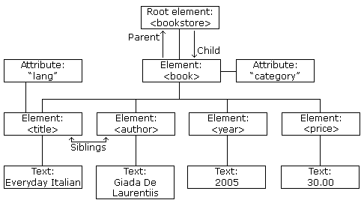
Introduction XML(cont..)
Example Of XML DOM
Ajeet Kumar WT UNIT 2

Slide 111
Introduction XML(cont..)
Example Of XML DOM(cont..)
<!DOCTYPE html>
<html>
<body>
<p id="demo"></p>
<script>
var xhttp = new XMLHttpRequest();
xhttp.onreadystatechange = function() {
if (this.readyState == 4 && this.status == 200) {
myFunction(this); } }
Ajeet Kumar WT UNIT 2

Slide 112
Introduction XML(cont..)
Example Of XML DOM(cont..)
xhttp.open("GET", "books.xml", true);
xhttp.send();
function myFunction(xml) {
var xmlDoc = xml.responseXML;
document.getElementById("demo").innerHTML =
xmlDoc.getElementsByTagName("title")[0].childNodes[0].nodeValue;
}
</script>
</body>
</html>
Ajeet Kumar WT UNIT 2

Slide 113
Introduction XML(cont..)
Presenting and using XML
  Presenting XML is a Java web application framework for presenting HTML, PDF, WML etc. in a device independent manner.
  It aims to achieve a complete separation of content and presentation.
  It supports various kinds of content including XML files, dynamic content, SQL result sets and flat files.
  Presenting XML may be used as a command line tool or as a framework for a servlet-based web application
Ajeet Kumar WT UNIT 2

Slide 114
Previous Topics: Recap
  The topic was focused on Object Model concepts in XML which includes
    Introduction
    XML Examples
    Syntax
    Features
    Benefits
  Presentation using XML.
  It was also discussed about XML DTD, XML Schema and XML Document Object Model(DOM).
Ajeet Kumar WT UNIT 2

Slide 115
UNIT 2
Topic’s Objective:
  To learn the concepts about presenting and using XML by DOM and SAX parsers.
Ajeet Kumar WT UNIT 2

Slide 116
Introduction XML(cont..)
XML Processors
When a software program reads an XML document and takes actions accordingly, this is called processing the XML.
Any program that can read and process XML documents is known as an XML processor.
An XML processor reads the XML file and turns it into in-memory structures that the rest of the program can access.
This is called a parser, and it is an important component of every XML processing program.
Ajeet Kumar WT UNIT 2

Slide 117
Introduction XML(cont..)
XML Parsers
An XML parser is a software library or package that provides interfaces for client applications to work with an XML document.
The XML Parser is designed to read the XML and create a way for programs to use XML.
XML parser validates the document and check that the document is well formatted.
Ajeet Kumar WT UNIT 2

Slide 118
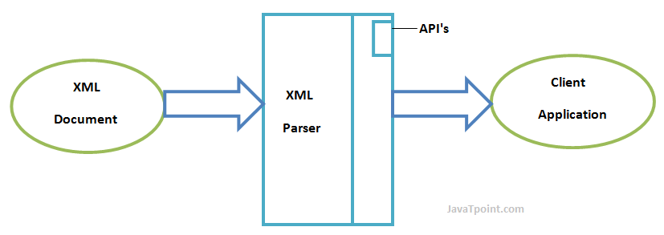
Introduction XML(cont..)
XML Parsers(cont..)
Ajeet Kumar WT UNIT 2

Slide 119
Introduction XML(cont..)
DOM (Document Object Model) parser
A DOM document is an object which contains all the information of an XML document.
It is composed like a tree structure.
The DOM Parser implements a DOM API.
This API is very simple to use.
Ajeet Kumar WT UNIT 2

Slide 120
Introduction XML(cont..)
DOM (Document Object Model) parser(cont..)
Advantages
  It supports both read and write operations and the API is very simple to use.
  It is preferred when random access to widely separated parts of a document is required.
Disadvantages
  It consumes more memory because the whole XML document needs to loaded into memory.
  It is comparatively slower than other parsers.
Ajeet Kumar WT UNIT 2

Slide 121
Introduction XML(cont..)
SAX (Simple API for XML) parser
A SAX Parser implements SAX API.
This API is an event based API and less intuitive.
It does not create any internal structure.
Clients does not know what methods to call, they just overrides the methods of the API and place his own code inside method.
It is an event based parser, that works like an event handler in Java.
Ajeet Kumar WT UNIT 2

Slide 122
Introduction XML(cont..)
SAX (Simple API for XML) parser(cont..)
Advantages
  It is simple and memory efficient.
  It is very fast and works for huge documents.
Disadvantages
  It is event-based so its API is less intuitive.
  Clients never know the full information because the data is broken into pieces.
Ajeet Kumar WT UNIT 2

Slide 123
Previous Topics: Recap
  The topic was focused on XML processor which includes
    Introduction
    Syntax
    Features
    Benefits
  The topic focused on Parser and DOM Parser
  Also discussed about SAX (Simple API for XML)
  It was discussed the concepts about presenting and using XML by DOM and SAX parsers.
Ajeet Kumar WT UNIT 2

Slide 124
UNIT 2
Objective of the above topics: To learn the concepts of following points
Namespace
Attribute
Tree
Elements
Display
HTTP Request
Parser
DOM
Xpath
XSLT
XQuery
Ajeet Kumar WT UNIT 2

Slide 125
UNIT 2
Objective of the above topics: To learn the concepts of following points
Xlink
Validator
Schema
Server
Ajeet Kumar WT UNIT 2

Slide 126
Introduction XML(cont..)
Namespaces
XML Namespaces provide a method to avoid element name conflicts.
Name Conflicts
In XML, element names are defined by the developer. This often results in a conflict when trying to mix XML documents from different XML applications.
This XML carries HTML table information:
This XML carries information about a table (a piece of furniture):
<table>
<name>African Coffee Table</name>
<width>80</width>
<length>120</length>
</table>
<table>
<tr>
<td>Apples</td>
<td>Bananas</td>
</tr>
</table>
Ajeet Kumar WT UNIT 2

Slide 127
Introduction XML(cont..)
If these XML fragments were added together, there would be a name conflict. Both contain a <table> element, but the elements have different content and meaning.
A user or an XML application will not know how to handle these differences.
Solving the Name Conflict Using a Prefix:
Name conflicts in XML can easily be avoided using a name prefix.
This XML carries information about an HTML table, and a piece of furniture:
Ajeet Kumar WT UNIT 2

Slide 128
Introduction XML(cont..)
<h:table>
<h:tr>
<h:td>Apples</h:td>
<h:td>Bananas</h:td>
</h:tr>
</h:table>
<f:table>
<f:name>African Coffee Table</f:name>
<f:width>80</f:width>
<f:length>120</f:length>
</f:table>
In the example above, there will be no conflict because the two <table> elements have different names.
Ajeet Kumar WT UNIT 2

Slide 129
XML DISPLAY
Raw XML files can be viewed in all major browsers.
Don't expect XML files to be displayed as HTML pages.
Viewing XML Files:
<?xml version="1.0" encoding="UTF-8"?>
- <note>
<to>Tove</to>
<from>Jani</from>
<heading>Reminder</heading>
<body>Don't forget me this weekend!</body>
</note>
Ajeet Kumar WT UNIT 2

Slide 130
XML DISPLAY
Look at the XML file above in your browser: note.xml
Most browsers will display an XML document with color-coded elements.
Often a plus (+) or minus sign (-) to the left of the elements can be clicked to expand or collapse the element structure.
To view raw XML source, try to select "View Page Source" or "View Source" from the browser menu.
Note: In Safari 5 (and earlier), only the element text will be displayed. To view the raw XML, you must right click the page and select "View Source".
Ajeet Kumar WT UNIT 2

Slide 131

XML :HTTP Request
The XMLHttpRequest object can be used to request data from a web server.
The XMLHttpRequest object is a developers dream, because you can:
Update a web page without reloading the page
Request data from a server - after the page has loaded
Receive data from a server - after the page has loaded
Send data to a server - in the background
When you type a character in the input field below, an XMLHttpRequest is sent to the server, and some name suggestions are returned (from the server):
Ajeet Kumar WT UNIT 2

Slide 132
XML :HTTP Request
Sending an XMLHttpRequest:
A common JavaScript syntax for using the XMLHttpRequest object looks much like this:
var xhttp = new XMLHttpRequest();
xhttp.onreadystatechange = function() {
if (this.readyState == 4 && this.status == 200) {
// Typical action to be performed when the document is ready:
document.getElementById("demo").innerHTML = xhttp.responseText;
}
};
xhttp.open("GET", "filename", true);
xhttp.send();
Ajeet Kumar WT UNIT 2

Slide 133
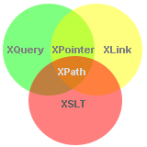
XML :XPath
XPath is a major element in the XSLT standard.
XPath can be used to navigate through elements and attributes in an XML document.
XPath is a syntax for defining parts of an XML document
XPath uses path expressions to navigate in XML documents
XPath contains a library of standard functions
XPath is a major element in XSLT and in XQuery
XPath is a W3C recommendation
Ajeet Kumar WT UNIT 2

Slide 134
XML :Xpath (Cont..)
XPath Path Expressions
XPath uses path expressions to select nodes or node-sets in an XML document. These path expressions look very much like the expressions you see when you work with a traditional computer file system.
XPath expressions can be used in JavaScript, Java, XML Schema, PHP, Python, C and C++, and lots of other languages.
XPath is Used in XSLT
XPath is a major element in the XSLT standard.
With XPath knowledge you will be able to take great advantage of XSL.
Ajeet Kumar WT UNIT 2

Slide 135
XML :Xpath (Cont..)
<?xml version="1.0" encoding="UTF-8"?>
<bookstore>
<book category="cooking">
<title lang="en">Everyday Italian</title>
<author>Giada De Laurentiis</author>
<year>2005</year>
<price>30.00</price>
</book>
<book category="children">
<title lang="en">Harry Potter</title>
<author>J K. Rowling</author>
<year>2005</year>
<price>29.99</price>
</book>
<book category="web">
<title lang="en">XQuery Kick Start</title>
<author>James McGovern</author>
<author>Per Bothner</author>
<author>Kurt Cagle</author>
<author>James Linn</author>
<author>Vaidyanathan Nagarajan</author>
<year>2003</year>
<price>49.99</price>
</book>
<book category="web">
<title lang="en">Learning XML</title>
<author>Erik T. Ray</author>
<year>2003</year>
<price>39.95</price>
</book>
</bookstore>
Ajeet Kumar WT UNIT 2

Slide 136
XML :Xpath (Cont..)
In the table below we have listed some XPath expressions and the result of the expressions:
XPath Expression | Result
/bookstore/book[1] | Selects the first book element that is the child of the bookstore element
/bookstore/book[last()] | Selects the last book element that is the child of the bookstore element
/bookstore/book[last()-1] | Selects the last but one book element that is the child of the bookstore element
/bookstore/book[position()<3] | Selects the first two book elements that are children of the bookstore element
//title[@lang] | Selects all the title elements that have an attribute named lang
//title[@lang='en'] | Selects all the title elements that have a "lang" attribute with a value of "en"
Ajeet Kumar WT UNIT 2

Slide 137
XML :Xpath (Cont..)
In the table below we have listed some XPath expressions and the result of the expressions:
XPath Expression | Result
/bookstore/book[price>35.00] | Selects all the book elements of the bookstore element that have a price element with a value greater than 35.00
/bookstore/book[price>35.00]/title | Selects all the title elements of the book elements of the bookstore element that have a price element with a value greater than 35.00
Ajeet Kumar WT UNIT 2

Slide 138
XML :XSLT
XSLT (eXtensible Stylesheet Language Transformations) is the recommended style sheet language for XML.
XSLT is far more sophisticated than CSS. With XSLT you can add/remove elements and attributes to or from the output file. You can also rearrange and sort elements, perform tests and make decisions about which elements to hide and display, and a lot more.
XSLT uses XPath to find information in an XML document.
Ajeet Kumar WT UNIT 2

Slide 139
XML :XSLT (Cont..)
<description>Light Belgian waffles covered with an assortment of fresh berries and whipped cream</description>
<calories>900</calories>
</food>
<food>
<name>French Toast</name>
<price>$4.50</price>
<description>Thick slices made from our homemade sourdough bread</description>
<calories>600</calories>
</food>
<food>
<name>Homestyle Breakfast</name>
<price>$6.95</price>
<description>Two eggs, bacon or sausage, toast, and our ever-popular hash browns</description>
<calories>950</calories>
</food>
</breakfast_menu>
<?xml version="1.0" encoding="UTF-8"?>
<breakfast_menu>
<food>
<name>Belgian Waffles</name>
<price>$5.95</price>
<description>Two of our famous Belgian Waffles with plenty of real maple syrup</description>
<calories>650</calories>
</food>
<food>
<name>Strawberry Belgian Waffles</name>
<price>$7.95</price>
<description>Light Belgian waffles covered with strawberries and whipped cream</description>
<calories>900</calories>
</food>
<food>
<name>Berry-Berry Belgian Waffles</name>
<price>$8.95</price>
Ajeet Kumar WT UNIT 2

Slide 140
XML :XSLT (Cont..)
Use XSLT to transform XML into HTML, before it is displayed in a browser:
<?xml version="1.0" encoding="UTF-8"?>
<html xsl:version="1.0" xmlns:xsl="http://www.w3.org/1999/XSL/Transform">
<body style="font-family:Arial;font-size:12pt;background-color:#EEEEEE">
<xsl:for-each select="breakfast_menu/food">
<div style="background-color:teal;color:white;padding:4px">
<span style="font-weight:bold"><xsl:value-of select="name"/> - </span>
<xsl:value-of select="price"/>
</div>
<div style="margin-left:20px;margin-bottom:1em;font-size:10pt">
<p>
<xsl:value-of select="description"/>
<span style="font-style:italic"> (<xsl:value-of select="calories"/> calories per serving)</span>
</p>
</div>
</xsl:for-each>
</body>
</html>
Ajeet Kumar WT UNIT 2

Slide 141
XML :XQuery
XQuery is to XML what SQL is to databases.
XQuery was designed to query XML data.
for $x in doc("books.xml")/bookstore/book
where $x/price>30
order by $x/title
return $x/title
XQuery is the language for querying XML data
XQuery for XML is like SQL for databases
XQuery is built on XPath expressions
XQuery is supported by all major databases
XQuery is a W3C Recommendation
Ajeet Kumar WT UNIT 2

Slide 142
XML :XQuery (Cont..)
XQuery is About Querying XML
XQuery is a language for finding and extracting elements and attributes from XML documents.
Here is an example of what XQuery could solve:
"Select all CD records with a price less than $10 from the CD collection stored in cd_catalog.xml"
XQuery and XPath
XQuery 1.0 and XPath 2.0 share the same data model and support the same functions and operators. If you have already studied XPath you will have no problems with understanding XQuery.
XQuery - Examples of Use
XQuery can be used to:
Extract information to use in a Web Service
Generate summary reports
Transform XML data to XHTML
Search Web documents for relevant information
Ajeet Kumar WT UNIT 2

Slide 143
XML :XLink
XLink is used to create hyperlinks in XML documents.
XLink is used to create hyperlinks within XML documents
Any element in an XML document can behave as a link
With XLink, the links can be defined outside the linked files
XLink is a W3C Recommendation
XLink Syntax
In HTML, the <a> element defines a hyperlink. However, this is not how it works in XML. In XML documents, you can use whatever element names you want - therefore it is impossible for browsers to predict what link elements will be called in XML documents.
Below is a simple example of how to use XLink to create links in an XML document:
Ajeet Kumar WT UNIT 2

Slide 144
XML :Xlink (Cont..)
<?xml version="1.0" encoding="UTF-8"?>
<homepages xmlns:xlink="http://www.w3.org/1999/xlink">
<homepage xlink:type="simple" xlink:href="https://www.w3schools.com">Visit W3Schools</homepage>
<homepage xlink:type="simple" xlink:href="http://www.w3.org">Visit W3C</homepage>
</homepages>
Ajeet Kumar WT UNIT 2

Slide 145
XML :Xlink (Cont..)
<?xml version="1.0" encoding="UTF-8"?>
<bookstore xmlns:xlink="http://www.w3.org/1999/xlink">
<book title="Harry Potter">
<description
xlink:type="simple"
xlink:href="/images/HPotter.gif"
xlink:show="new">
As his fifth year at Hogwarts School of Witchcraft and
Wizardry approaches, 15-year-old Harry Potter is.......
</description>
</book>
<book title="XQuery Kick Start">
<description
xlink:type="simple"
xlink:href="/images/XQuery.gif"
xlink:show="new">
XQuery Kick Start delivers a concise introduction
to the XQuery standard.......
</description>
</book>
</bookstore>
Ajeet Kumar WT UNIT 2

Slide 146
XML :Xlink (Cont..)
Example explained:
The XLink namespace is declared at the top of the document (xmlns:xlink="http://www.w3.org/1999/xlink")
The xlink:type="simple" creates a simple "HTML-like" link
The xlink:href attribute specifies the URL to link to (in this case - an image)
The xlink:show="new" specifies that the link should open in a new window
Ajeet Kumar WT UNIT 2

Slide 147
XML :Validator
An XML document with correct syntax is called "Well Formed".
The syntax rules were described in the previous chapters:
XML documents must have a root element
XML elements must have a closing tag
XML tags are case sensitive
XML elements must be properly nested
XML attribute values must be quoted
<?xml version="1.0" encoding="UTF-8"?>
<note>
<to>Tove</to>
<from>Jani</from>
<heading>Reminder</heading>
<body>Don't forget me this weekend!</body>
</note>
Ajeet Kumar WT UNIT 2

Slide 148
XML :Server
XML files are plain text files just like HTML files.
XML can easily be stored and generated by a standard web server.
Storing XML Files on the Server
XML files can be stored on an Internet server exactly the same way as HTML files.
Start Windows Notepad and write the following lines:
<?xml version="1.0" encoding="UTF-8"?>
<note>
<from>Jani</from>
<to>Tove</to>
<message>Remember me this weekend</message>
</note>
Ajeet Kumar WT UNIT 2

Slide 149
Youtube & NPTEL Video Links and Online Courses Details
https://www.youtube.com/watch?v=uEmF74eHRO8
https://www.youtube.com/watch?v=7GjHjZuYuAo
https://www.youtube.com/watch?v=ukazLQCyArY
https://www.youtube.com/watch?v=itRkLa2kq6w
https://www.youtube.com/watch?v=itRkLa2kq6w
https://www.youtube.com/watch?v=KJHYdkKtafU
https://www.youtube.com/watch?v=uUhOEj4z8Fo
https://www.youtube.com/watch?v=cXtUhpZJYz8&list=PLfn3cNtmZdPOe3R_wO_h540QNfMkCQ0ho&index=18
Ajeet Kumar WT UNIT 2

Slide 150
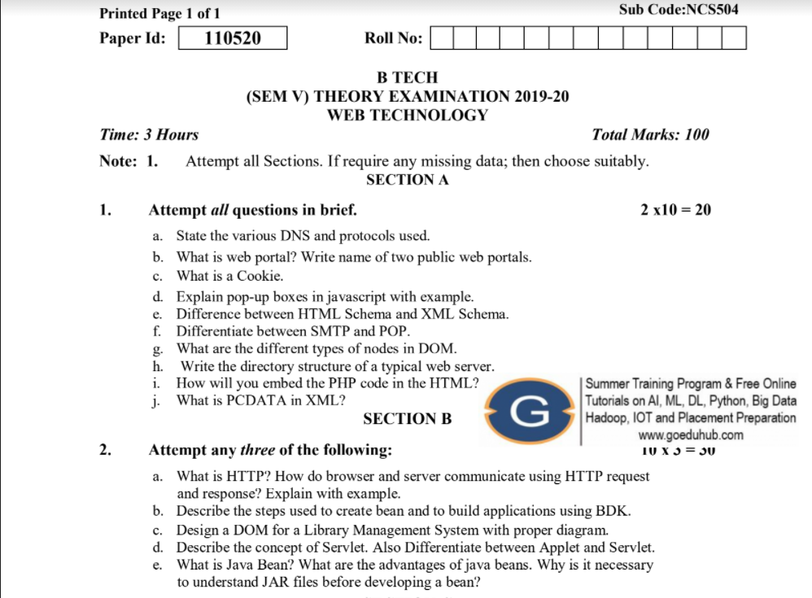
Old Question Paper
2019-20
https://drive.google.com/file/d/1eLOPdCx5cPPU08FiaBH3QiQnHTX_9xhk/view
Ajeet Kumar WT UNIT 2

Slide 151
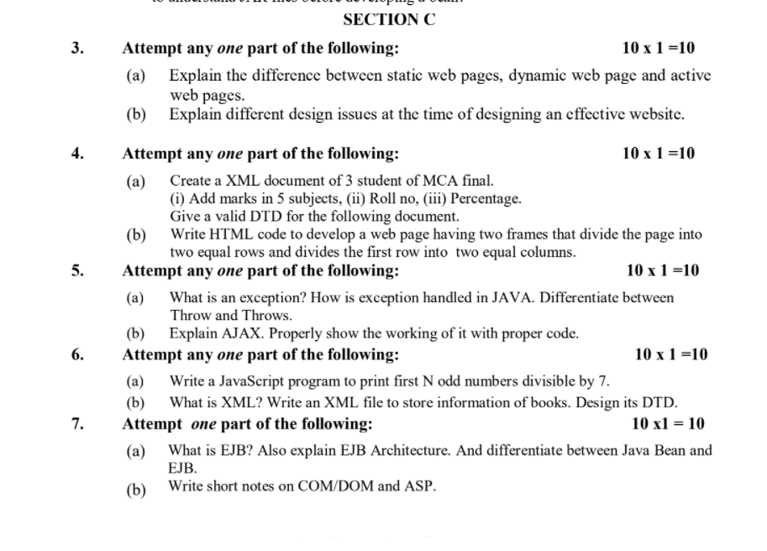
Old Question Paper(cont..)
Ajeet Kumar WT UNIT 2

Slide 152
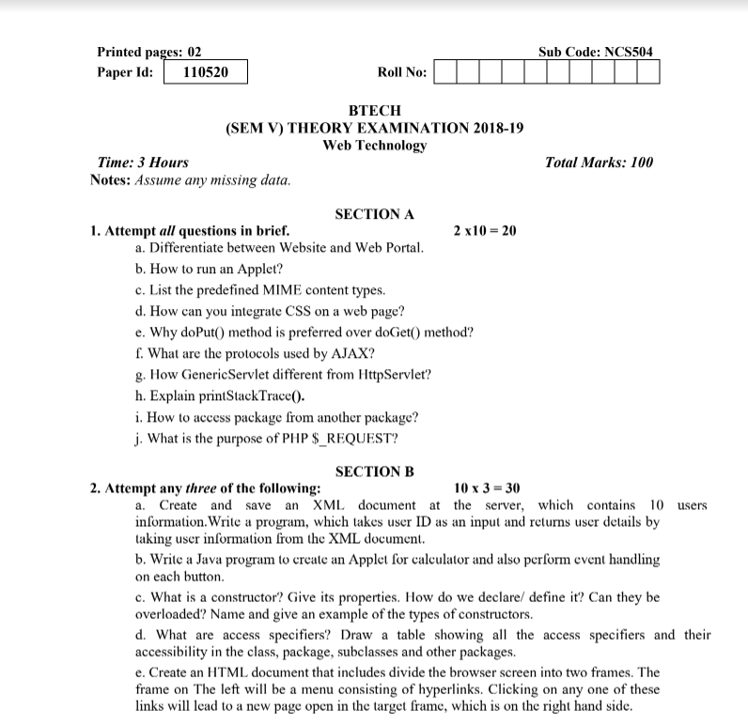
Old Question Paper(cont..)
2018-19
https://drive.google.com/file/d/1FsvkCgeo7sf1q4WRx7vh7A1fRNkJ0_2q/view
Ajeet Kumar WT UNIT 2

Slide 153
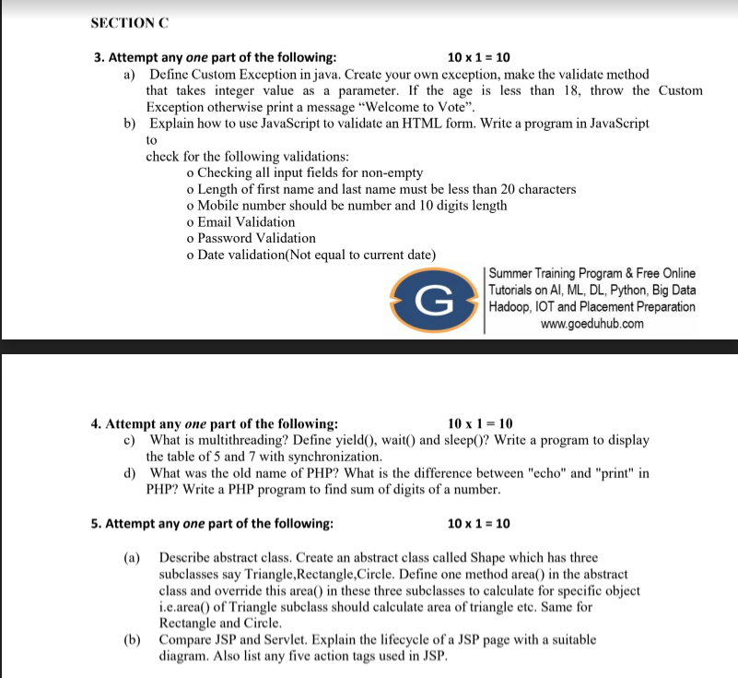
Old Question Paper(cont..)
Ajeet Kumar WT UNIT 2

Slide 154
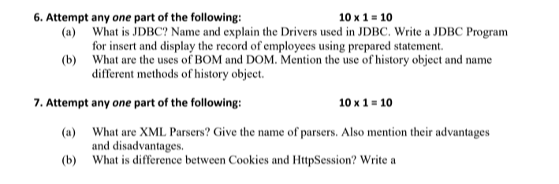
Old Question Paper(cont..)
Ajeet Kumar WT UNIT 2

Slide 155
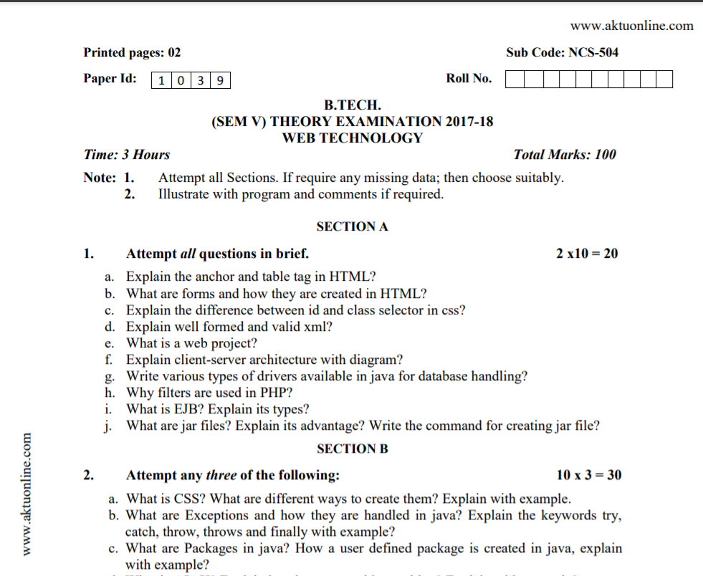
Old Question Paper(cont..)
2017-18
https://aktupapers.in/aktupapers/btech-cs-5-sem-web-technology-ncs-504-2017-18.pdf
Ajeet Kumar WT UNIT 2

Slide 156
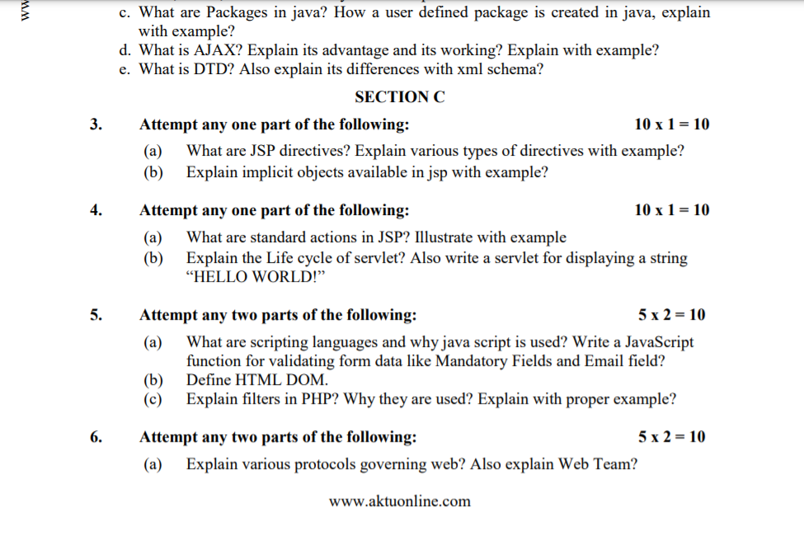
Old Question Paper(cont..)
Ajeet Kumar WT UNIT 2

Slide 157
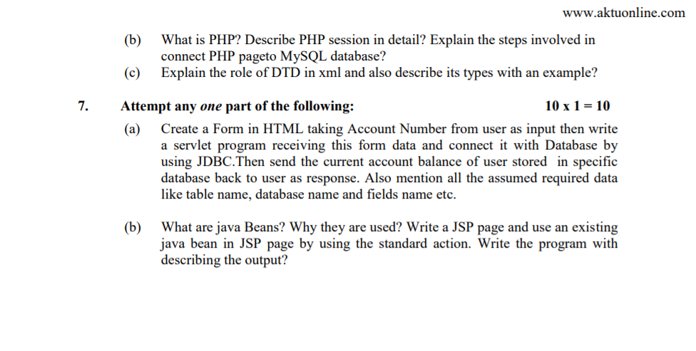
Old Question Paper(cont..)
Ajeet Kumar WT UNIT 2

Slide 158
References
Burdman, Jessica, “Collaborative Web Development” Addison Wesley
Xavier, C, “ Web Technology and Design” , New Age International
Ivan Bayross,” HTML, DHTML, Java Script, Perl & CGI”, BPB Publication
Ajeet Kumar WT UNIT 2

Slide 159
Recap of Unit 2
Designing web page using HTML
Designing Document Type definition in XML
Design and Development XML Schema and Document Object Model
Description of XML processors using DOM and SAX parser
XML Elements, Xpath, XSLT, Validator, Server, etc.
Ajeet Kumar WT UNIT 2

